Slide 1
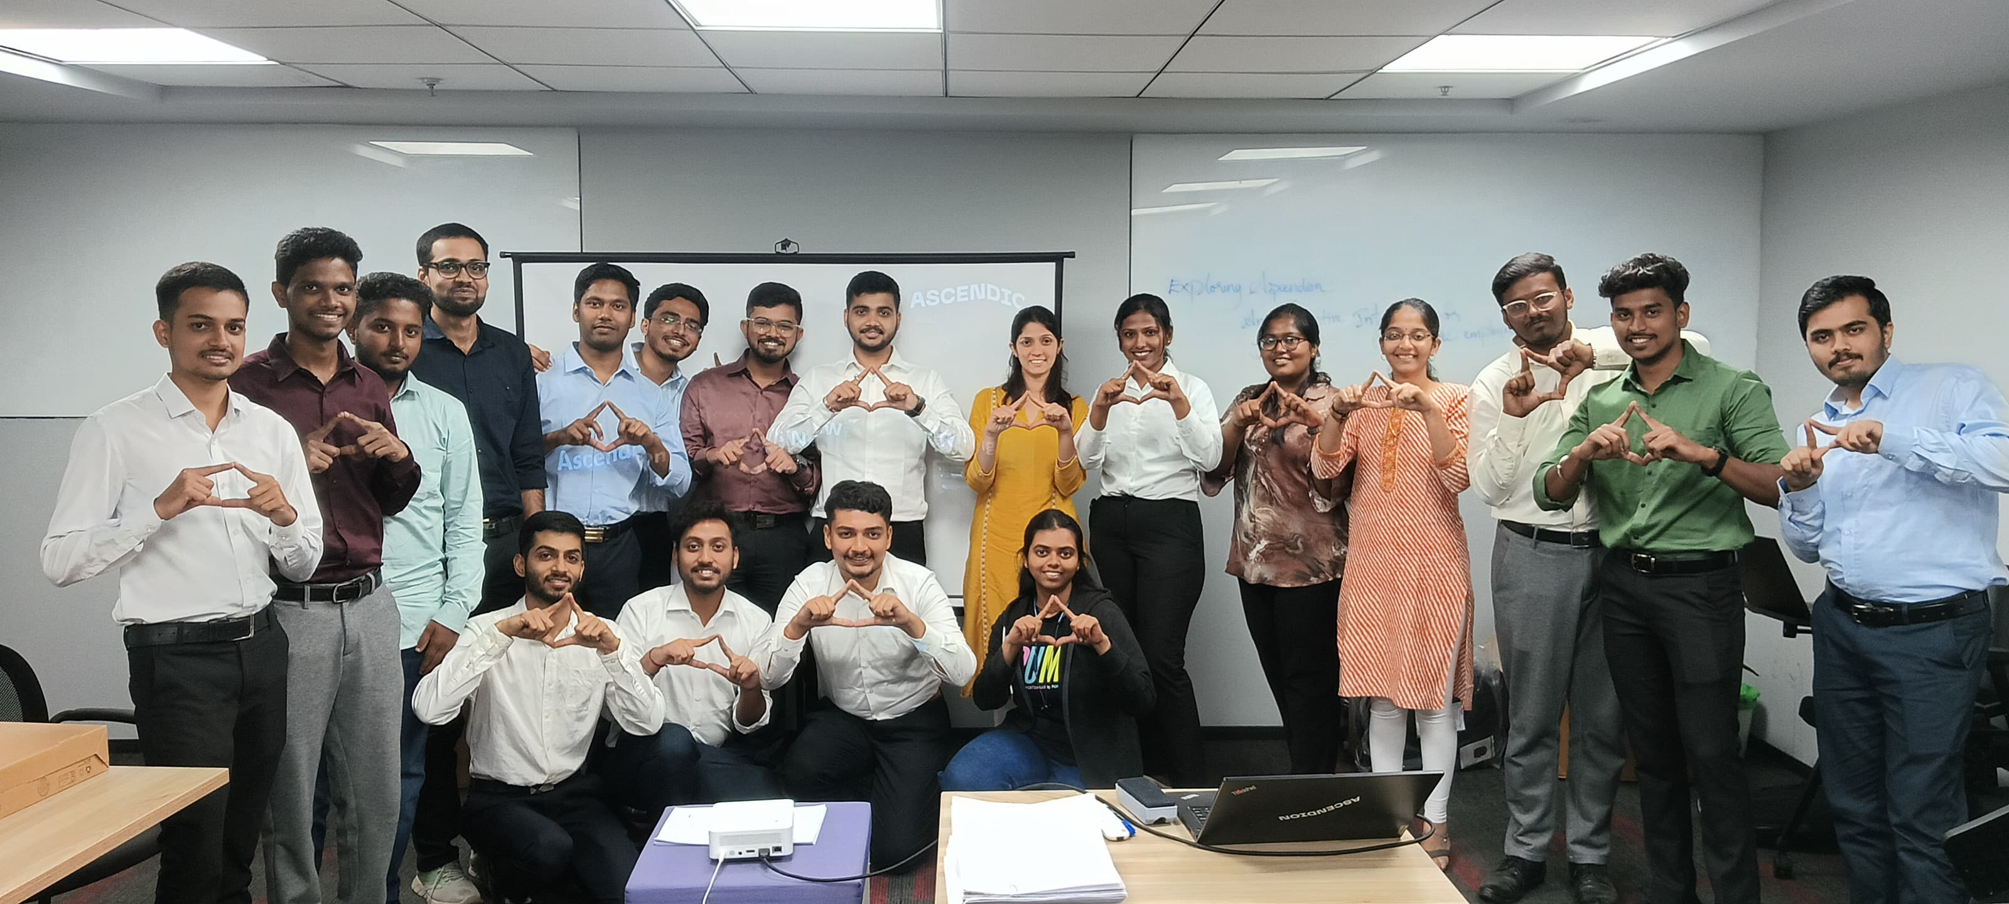

Exploring AsCendion- An interactive introduction for new employees
“Welcome to AsCendion, where we innovate for a brighter future!”
Presented by Team – 5 :- Harsh Mishra, Sandeep Reddi, Pavithra

Slide 2


Our Culture, Mission AND VISION
Company Culture: Ascendion has a unique culture that is inclusive, dynamic, and supportive. We believe that diverse perspectives fuel innovation.
Mission : Our mission is to positively impact every life we touch, through the power of diversity and our passion to serve.
Vision : Together we will positively impact billions of life through meaningful experiences with technology.

Slide 3
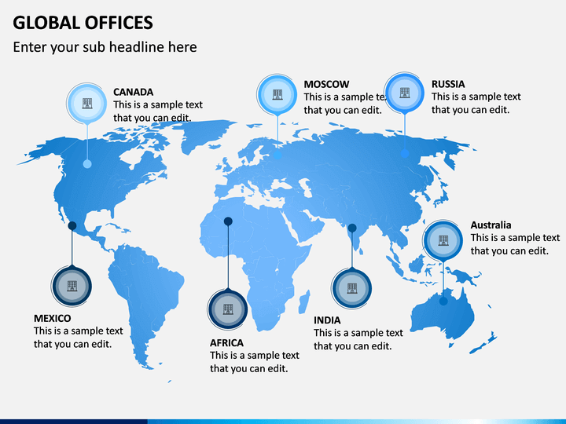
What We Do at Ascendion : Our Expertise & Services
Core Services: Digital engineering, cloud solutions, data analytics, AI, and software development.
Industries Served: Healthcare, finance, retail, and manufacturing.
Global Presence: Offices and projects across multiple countries
Ascendion accelerates digital transformation with AI-driven solutions, empowering businesses across various industries to innovate, modernize, and achieve sustainable growth.
achieve sustainable growth.

Slide 4
Thank you !

